Slide 1
Chongqing University of Technology
ATAI
Advanced Technique of Artificial Intelligence
Chongqing University of Technology
A Generalization of Transformer Networks to Graphs
Vijay Prakash Dwivedi,¶Xavier Bresson¶
¶School of Computer Science and Engineering, Nanyang Technological University, Singapore
vijaypra001@e.ntu.edu.sg, xbresson@ntu.edu.sg
AAAI_2021
Reported by Xinsheng Wang

Slide 2
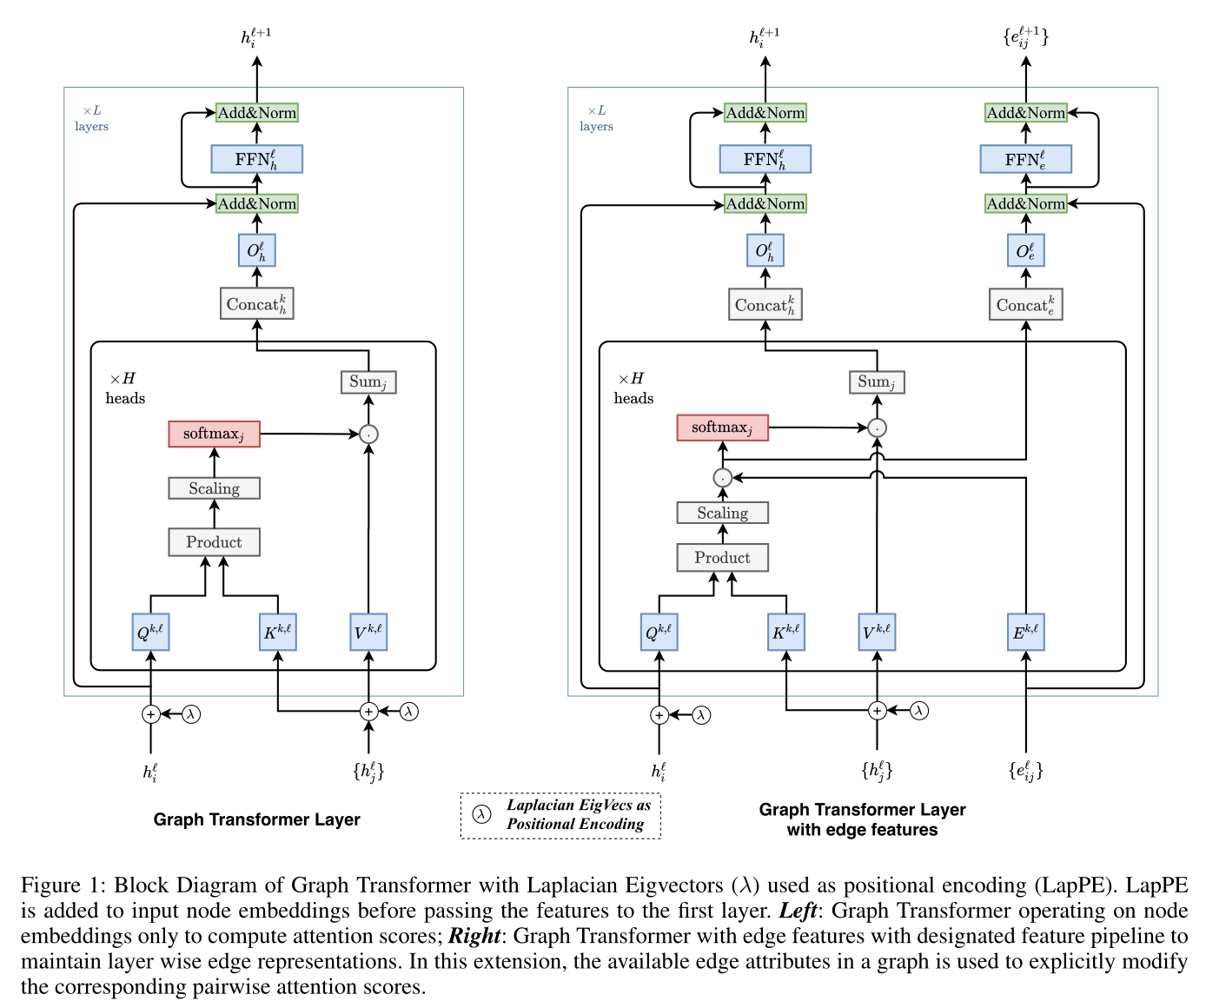
Method
input

Slide 3
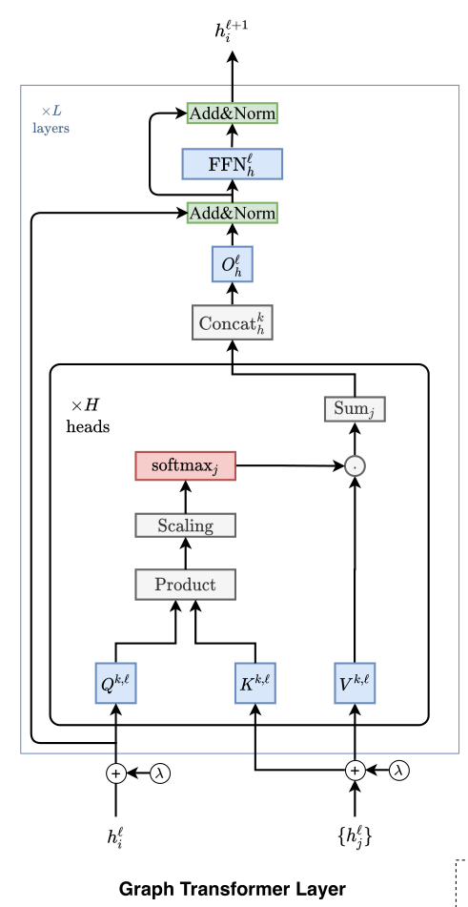
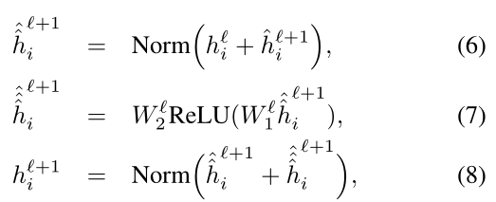
Method

Slide 4
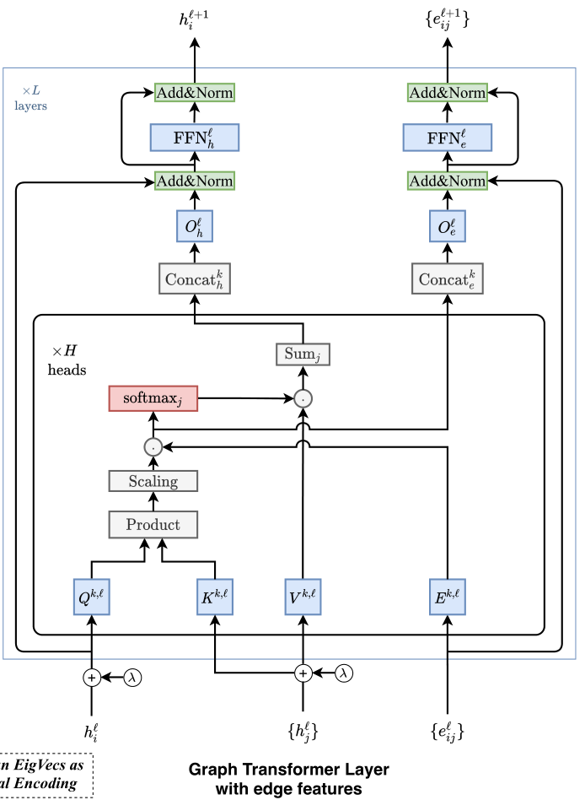
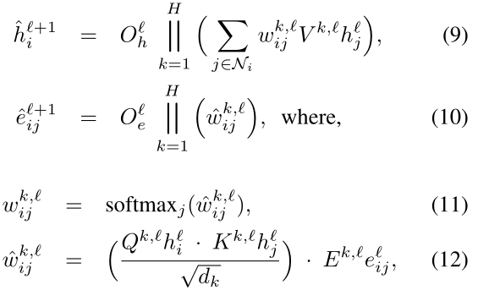
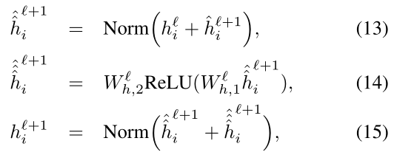
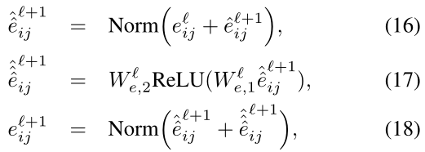
Method

Slide 5
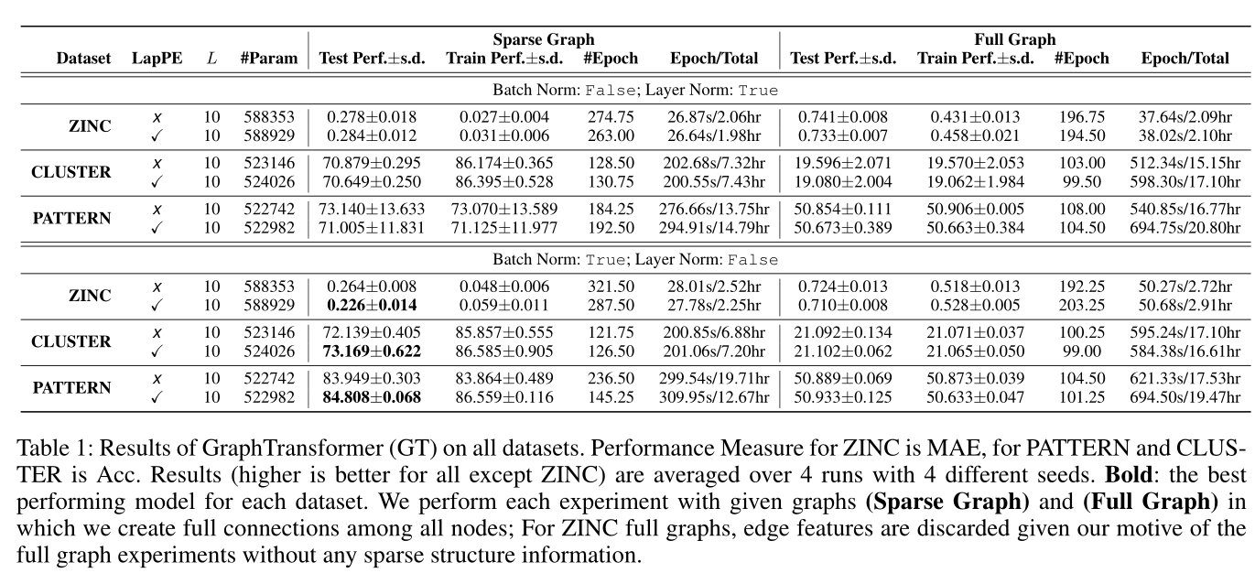
Experiments
Notes:
序列transformer中用layer norm效果更好；这里图的却是batch_norm更好

Slide 6
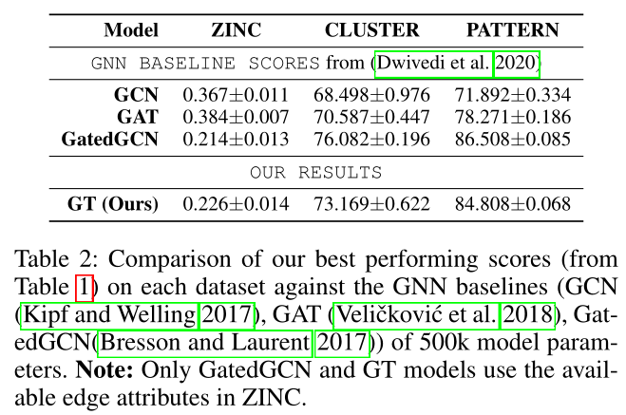
Experiments

Slide 7
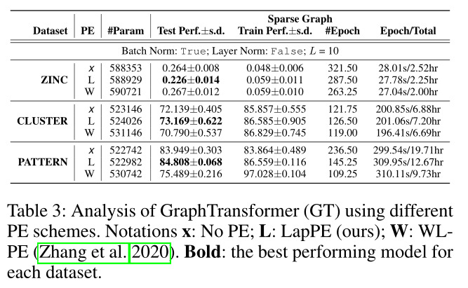
Experiments
Notes:
PE : position embedding

Slide 8
Thank you!

